Slide 1
2/2/2018

Slide 2
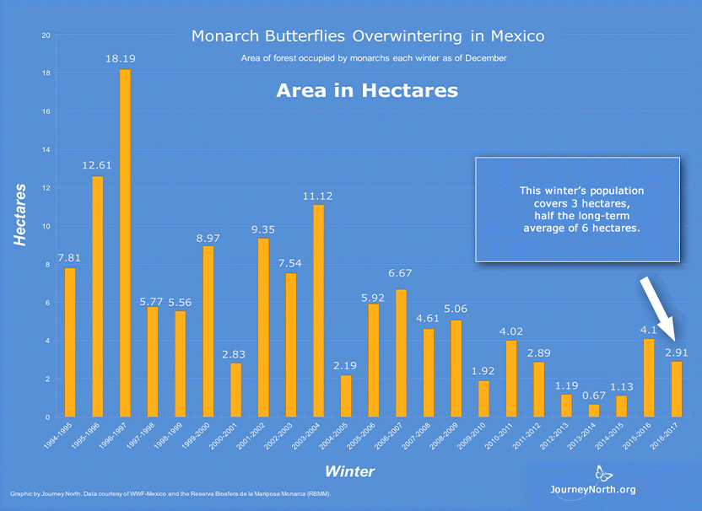
Task 1: Find out how many sensors are needed to cover the specified area.
Given:
Area
2.91 hectares
Sensor detection range
20, 30, or 60 m

Slide 3
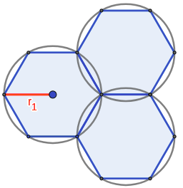
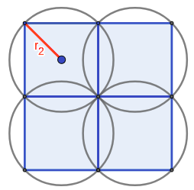
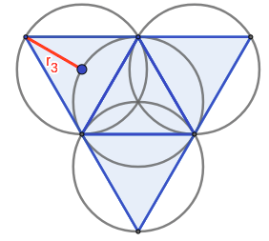
Possible Configurations
Hexagon Square Triangle

Slide 4
Comparison Between Configurations
Hexagon configuration gives largest area with the same radius
Triangle configuration completely overlaps
Configuration: | Hexagon | Square | Triangle
Effective area
Overlapped percentage in effective area | 20.9% | 57.0% | 100%

Slide 5
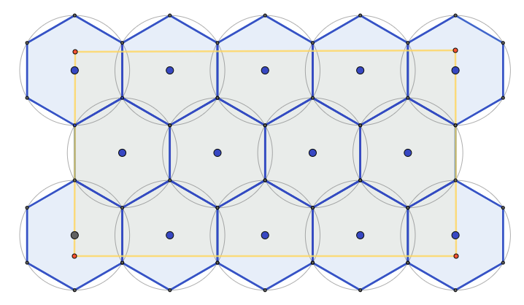
Hexagon Configuration

Slide 6
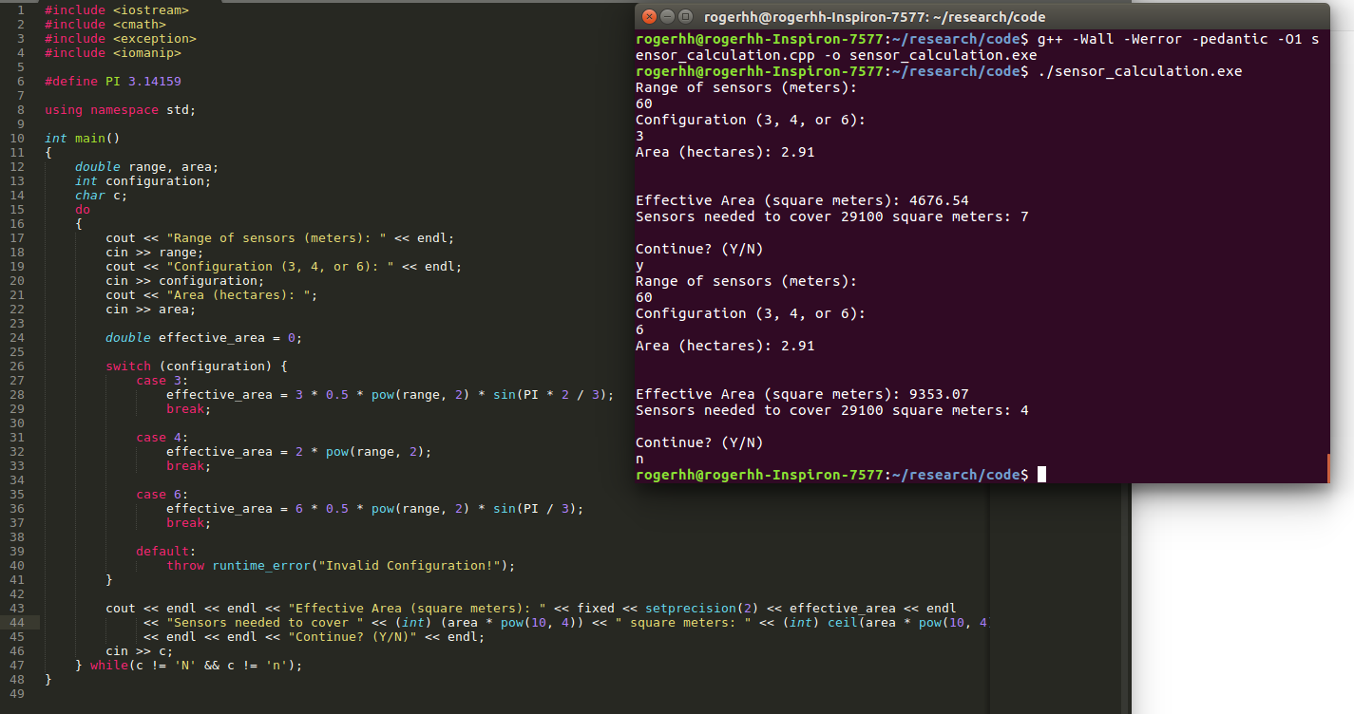
Automated Calculation
Calculates the number of sensors needed in with given sensor range, configuration, and area

Slide 7
Comparison Between Different Sensor Ranges
Sensor range: | 20 m | 30 m | 60 m
Effective coverage | 1039 m² | 2338 m² | 9353 m²
Sensors needed to cover 2.91 hectares | 29 | 13 | 4

Slide 8
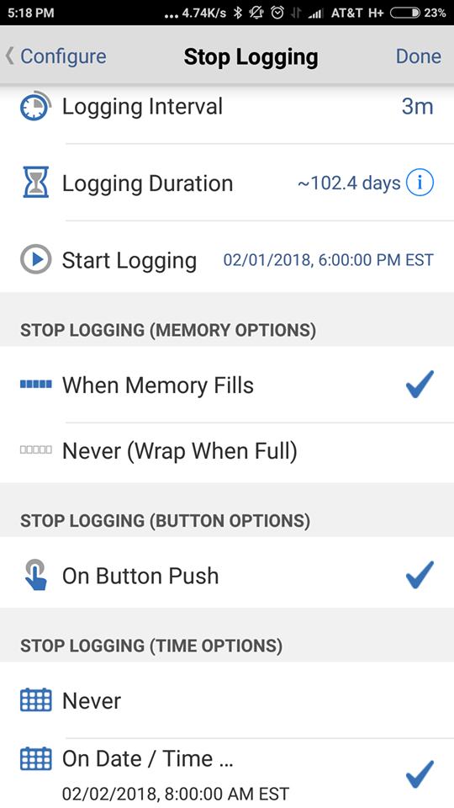
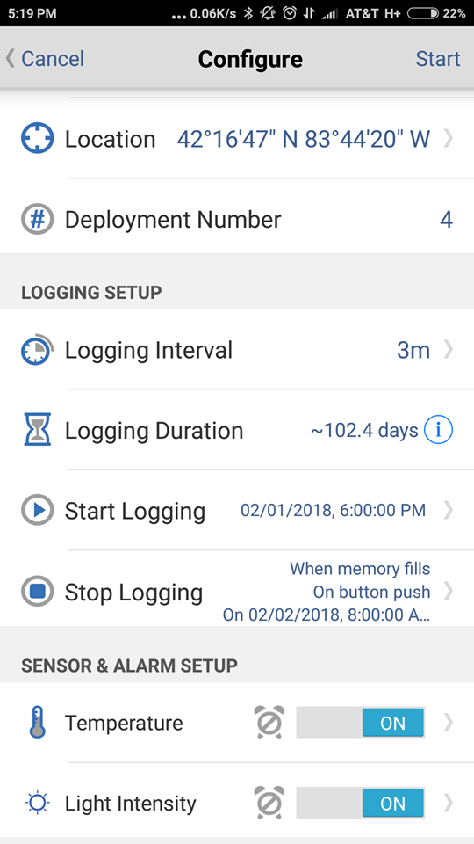
Task 2: Set up the HOBO MX 2202 Data Loggers
Records temperature and light intensity over time.
Able to set up start time and end time.
Able to set up log intervals.
Able to save files to multiple devices as graphs, CSV files, or plain text files

Slide 9
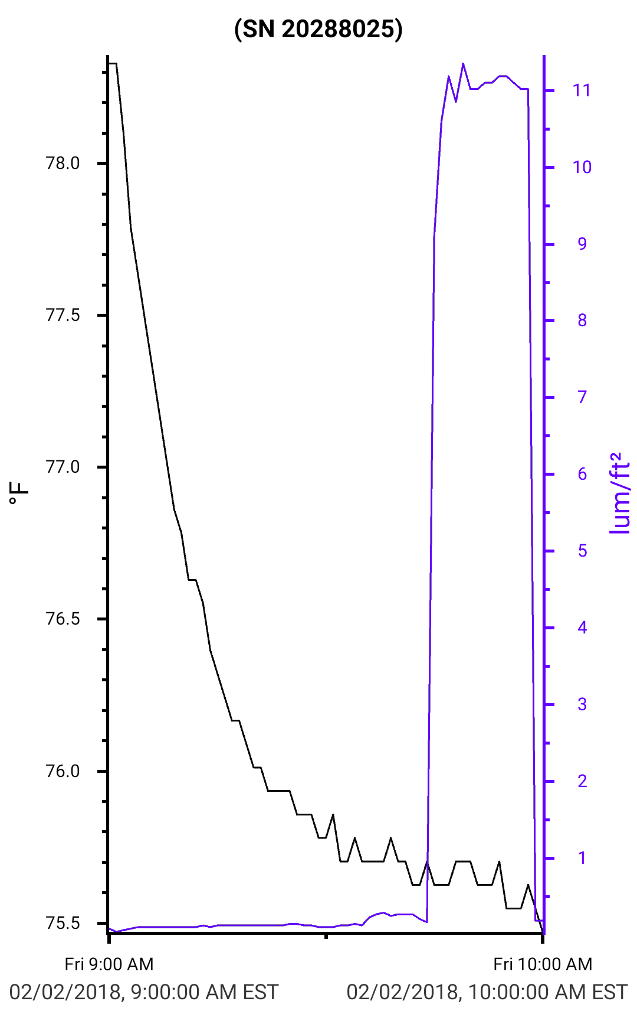
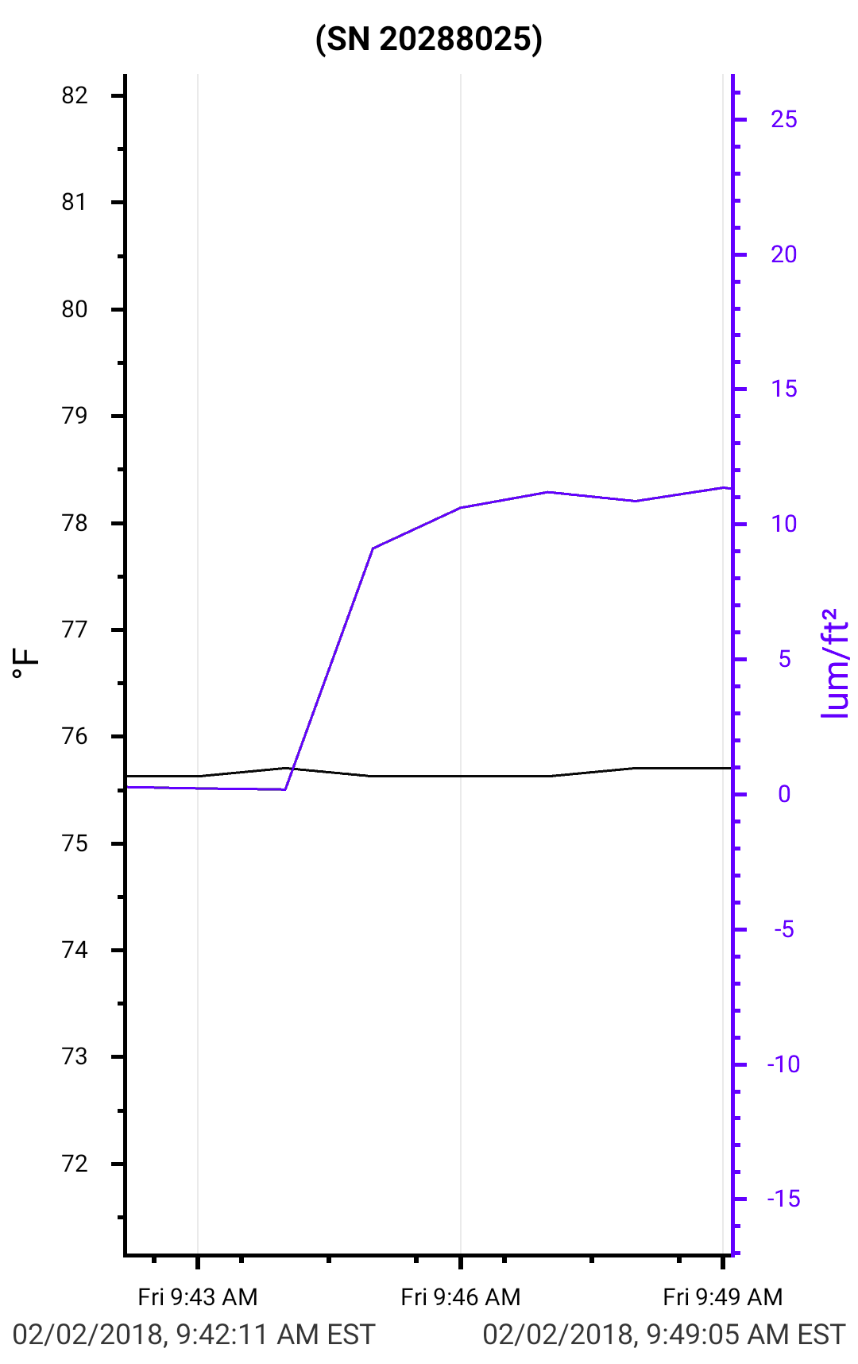
Roommate Data

Slide 10
Roommate Data

